Slide 1



Predicting Income via Machine Learning
A Presentation by Yaw Agipong
January 12, 2023

Slide 2
Background Information
A person’s Income level is a highly desired metric for companies and organizations in nearly every sector of the economy
Income levels are commonly used as a stand-in for a person’s attractiveness (or riskiness) as a customer
Organizations collect lots of information on their potential customers, but they don’t explicitly ask a customer to self-report their income level

Slide 3
The Stakeholder
Trust/risk sector
credit card issuers, mortgage brokers
Consumer goods marketers
healthcare industry

Slide 4
The Problem
Health insurance companies need a tool to predict income levels based on a customer’s demographic information to design portfolios that best fit both the needs and the means of their customers.

Slide 5
The Data
This model analyzed Demographic information from thousands of potential customers
48,000+ unique customer profiles
age, race education level, marital status, country of origin, occupation, etc.

Slide 6
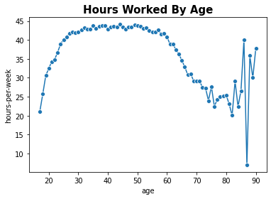
Visualization #1
People aged 30-60 work the most and are the most consistent in how much they work. Once people get older, their working level becomes more varied.

Slide 7
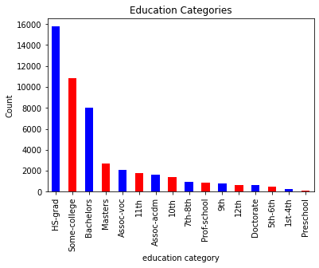
Visualization #2
One consideration to note about this dataset is that it skews less educated than the US national average. Roughly 52% of people in this dataset have completed schoolwork beyond high school, whereas the national average in 2021 was 63%.

Slide 8
The Model
What is the model?
A classification model that predicts whether a customer’s income level is above or below $50,000
If the model outputs a “1”, then it predicts that the customer has an income level above $50,000
If the model outputs a “0” then it predicts that the customer has an income level at or below $50,000
Model Strengths
The model is very easy to interpret
Model Limitations
The model is constrained by whatever demographics the analyst chooses to include

Slide 9
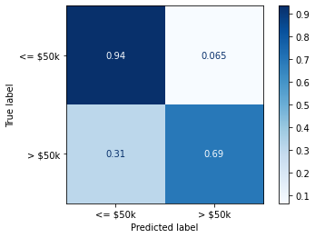
Results
The model performed quite well in minimizing false positives (a customer was predicted to be higher income but really was lower income) but had some issues with false negatives (a customer is predicted to be low income but really is high income)
Misidentifying high-income people as lower income might lead an insurance company to disqualify a high-income person from a premium policy erroneously

Slide 10
Conclusions & Recommendations
If health insurance companies want to predict their customers’ income levels, they need to consider a wide array of demographic data
The datasets considered also must be balanced to avoid bias. One glaring issue in this dataset was the lack of racial diversity in the demographic pool
Insurers could use this model as a starting point for crafting policies, but solely relying on it raises ethical and legal issues

Slide 11


Questions?

